Slide 1
Indiana High School Graduation Rate Analysis
Group 1: Brittany Schultz, Chris Ballard, Avery Vann, Bryan Smith, and Hope Neely

Slide 2
Motivation & Summary
This project’s goal is to dig into the graduation rates in Indiana schools by separating out those students who graduated receiving a waiver in lieu of completing graduation requirements. This is a common practice for students in the special education programs. Our concern is students that are not in special education programs but, placed on a non-diploma path through their high school years. Then graduating with a waiver of graduation requirements.
Hypothesis
Questions and why
Where questions satisfied? Summarize findings.

Slide 3
Questions & Data
What is the difference between the waiver graduation rate and non-graduation rate?
What is the relationship between the students attending schools relying heavily on waivers to graduate their students. Are these students also in lower socio-economic groups?
What factors play into the schools that have a larger waiver graduation presence? What letter grades does the state give these schools? What do their budget look like?
We were able to find data around this issue at the Indiana Department of Education’s website, https://www.doe.in.gov/accountability/growth, and the Census Bureau’s website, https://www.census.gov/.

Slide 4
So What is the difference between the waiver graduation rate and non-graduation rate?
The waiver graduation rate reflects the percentage of all students who graduate, including those qualifying for waivers to graduate despite not completing all requirements. The non-waiver graduation rate counts only the students who completed all graduation requirements.

Slide 5
Data Cleanup
The data cleanup process was more difficult than expected as the data we gathered wasn’t consistent. We started with over 300 school corporations however ended up only having consistent data for 268 corporations.
Different data sets had the school corporation names spelled differently, which added difficulty in the data cleanup process. (eg. “Corp” vs. “Corporation”)
Instead of manually weeding out the inconsistent data, I wrote a Python program to cross reference school corporation names and write any matches into a new file and any non-matches into a seperate file.
Once I had one cleaned file, I then wrote a program to match the unique corporation IDs that each file had to more rapidly clean the data with more automation.

Slide 6
Data Analysis

Slide 7
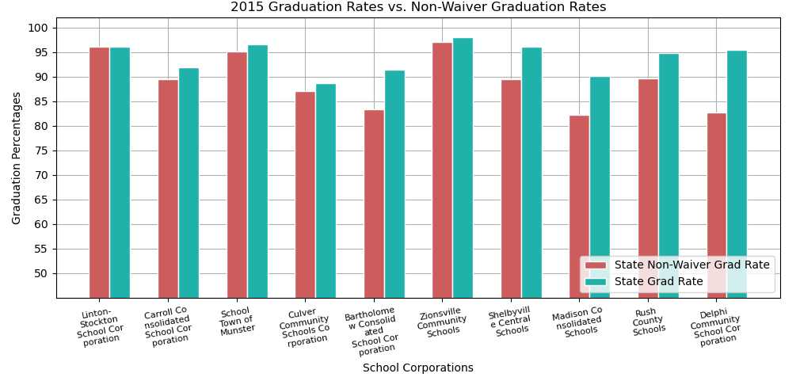
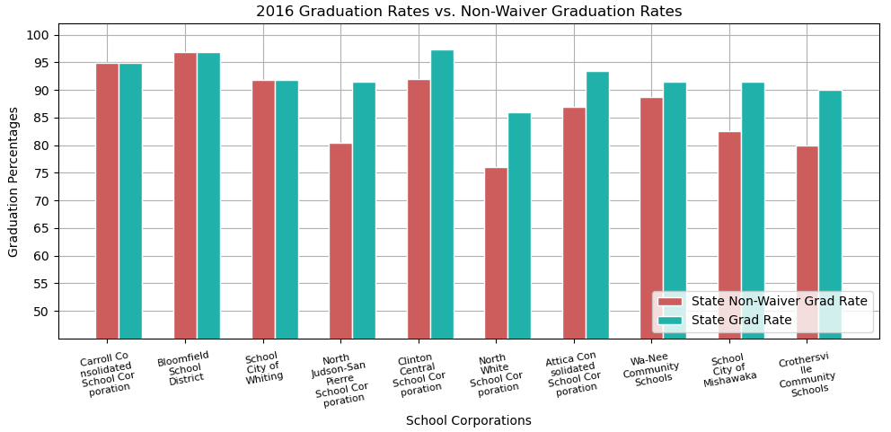
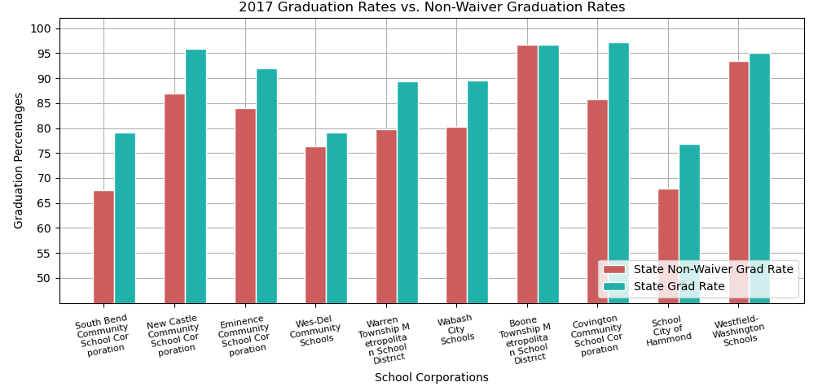
Waiver vs. Non-Waiver Graduation Rate

Slide 8
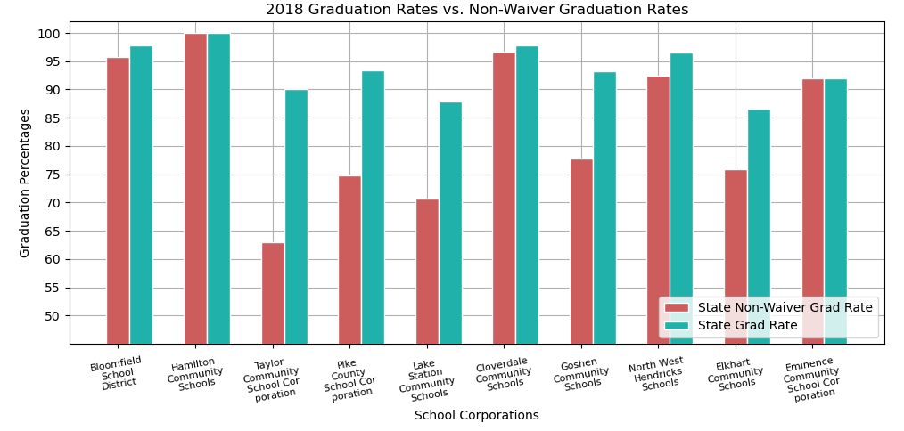
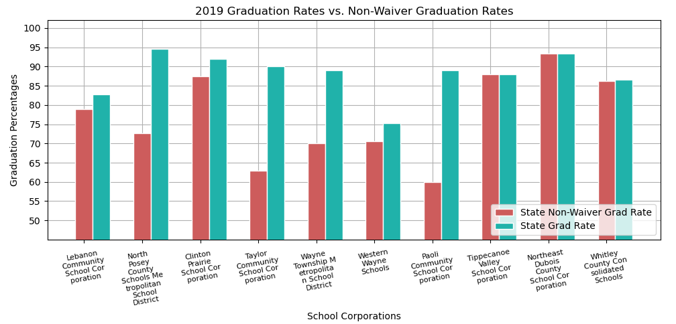
Waiver vs. Non-Waiver Graduation Rate

Slide 9
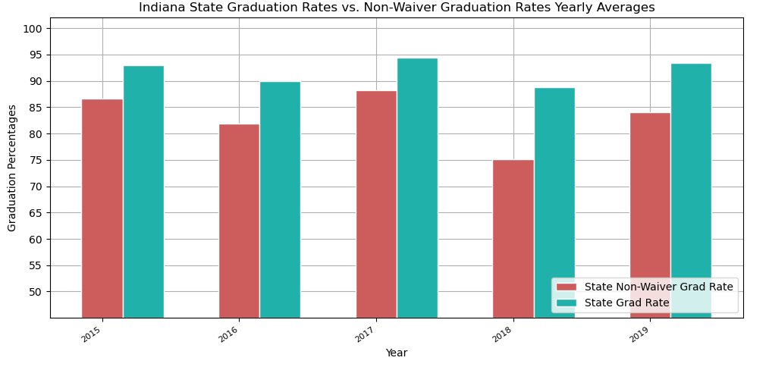
Waiver vs. Non-Waiver Graduation Rate

Slide 10
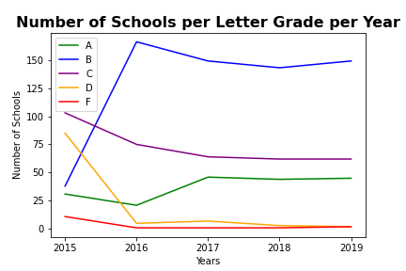
Relationship Analysis: School Grade vs. Change in Grad Rates

Slide 11
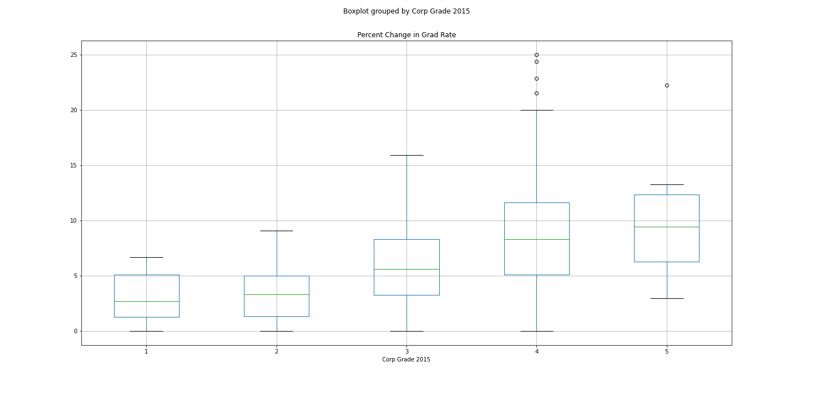
Relationship Analysis: School Grade vs. Change in Grad Rates
F_onewayResult(statistic=19.80090518567931, pvalue=2.905239341452868e-14)
The p-value is less than 0.05, meaning:
At least one of the letter grades is statistically different than the others.

Slide 12
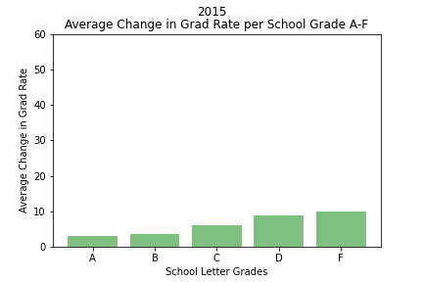
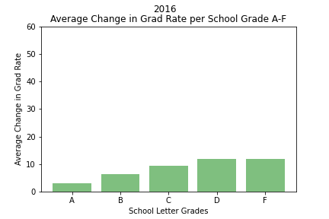
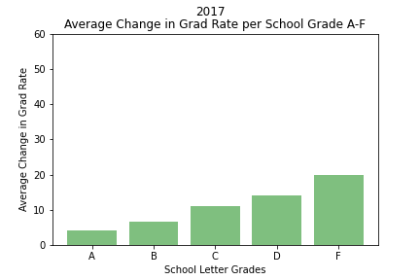
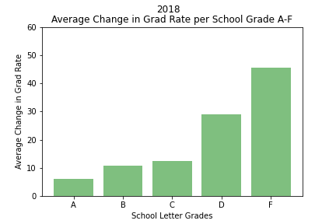
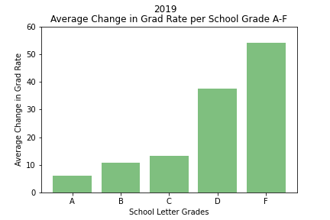
Relationship Analysis: School Grade vs. Change in Grad Rates

Slide 13
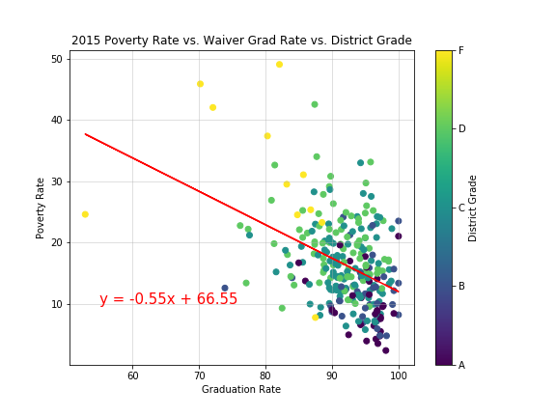
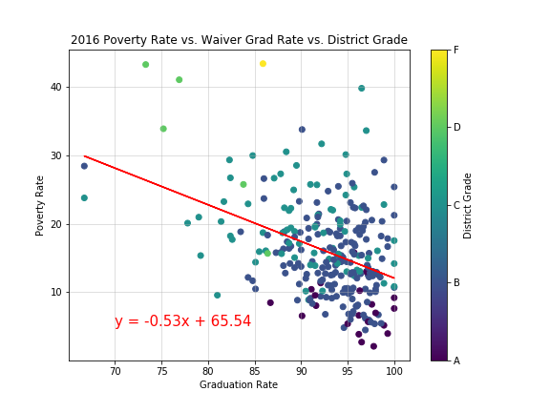
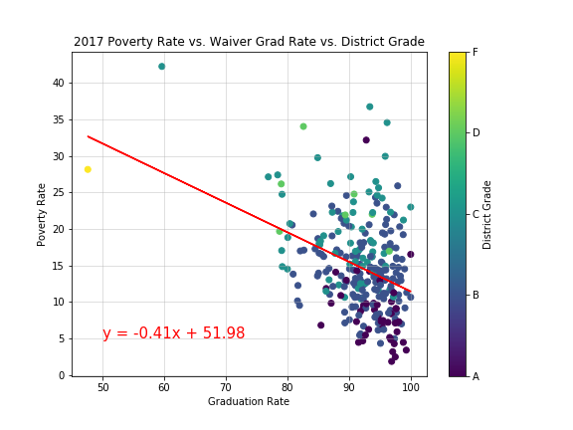
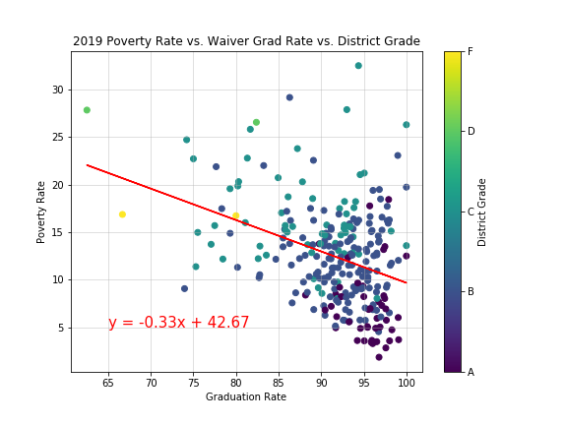
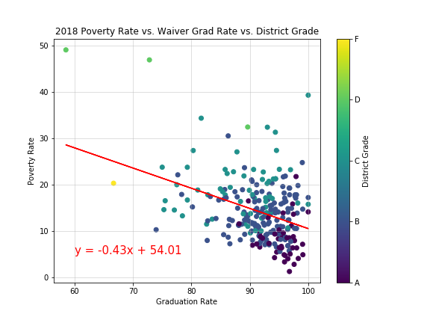
Relationship Analysis: Poverty vs. Waiver Grad Rates

Slide 14
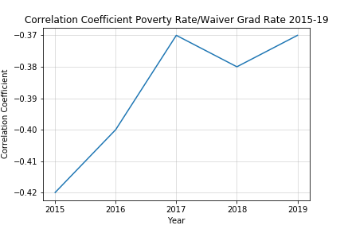
Relationship Analysis: Poverty vs. Waiver Grad Rates

Slide 15
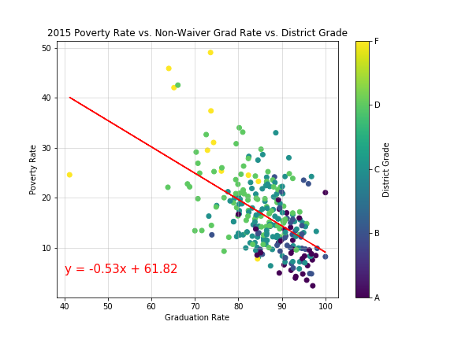
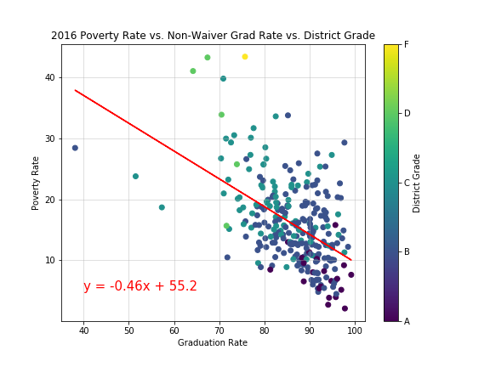
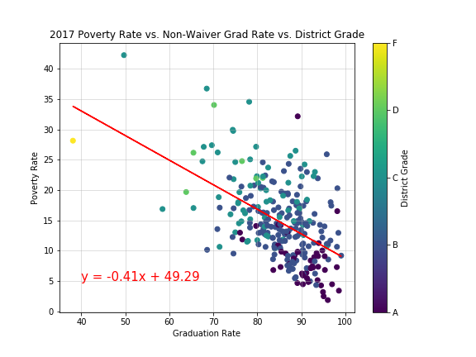
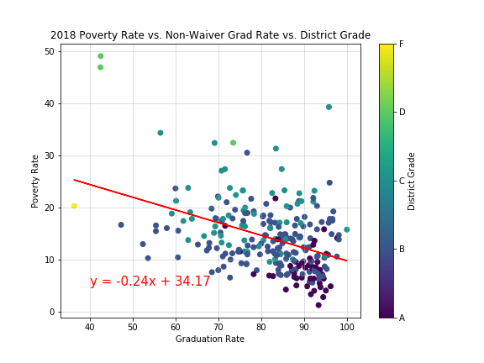
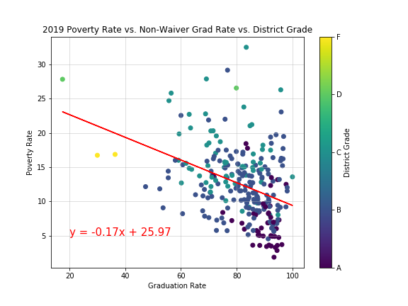
Relationship Analysis: Poverty vs. Non-Waiver Grad Rates

Slide 16
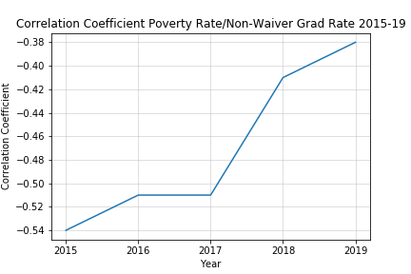
Relationship Analysis: Poverty vs. Non-Waiver Grad Rates

Slide 17
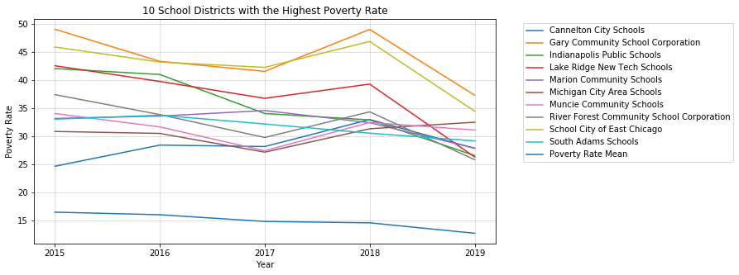
Relationship Analysis: Poverty vs. Grad Rates

Slide 18
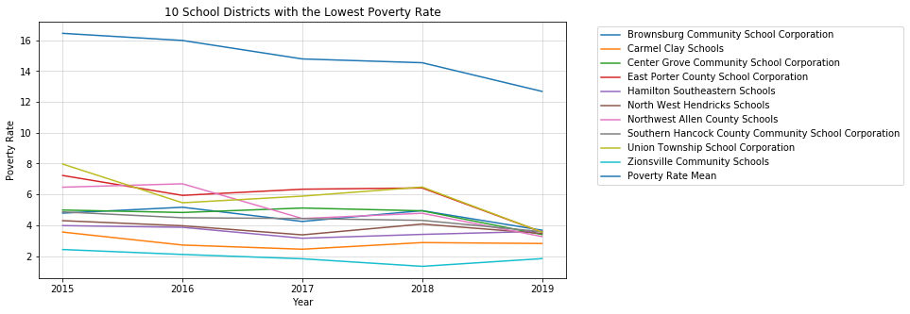
Relationship Analysis: Poverty vs. Grad Rates

Slide 19
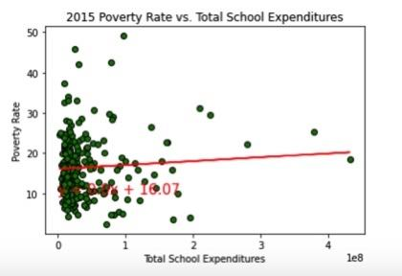
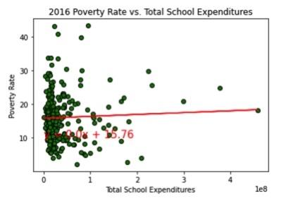
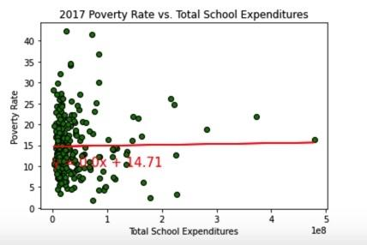
Relationship Analysis: Demographics vs. Grad Rates

Slide 20
Relationship Analysis: School Spending vs. Grad Rates

Slide 21
Discussion
Discuss findings. Did you find what you expected? If not, why not? What inferences or general conclusions can be drawn from your analysis.
Discuss any difficulties that arose, and how you dealt with them.
Discuss any additional questions that came up, but which you didn’t have time to answer: What would you research next, if you had two more weeks?
Questions?
Pandemic effects

